Slide 1
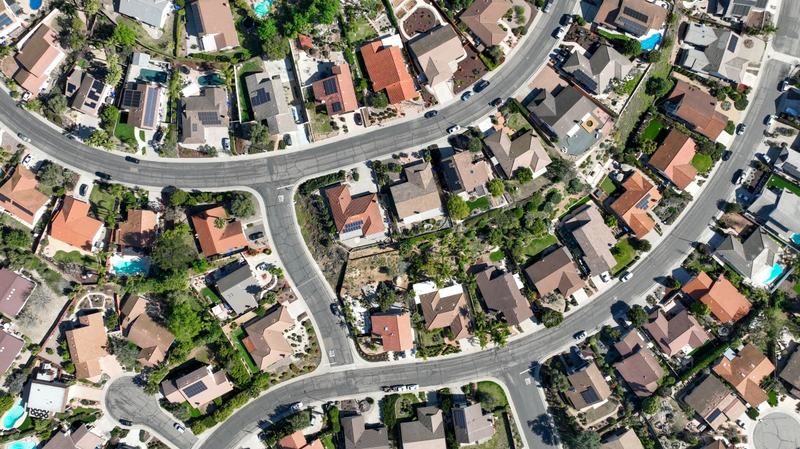
Data Dive into the Housing Data Set
By: Anastasia and Paola

Slide 2
What neighborhood has the highest collective sale price?
Collective sale price refers to the total sum of all the houses in one neighborhood.
Evaluating neighborhoods based on their collective sale price provides a comprehensive picture of real estate worth in different areas. This approach helps in understanding how these factors influence the sale price and what people are willing to pay.
The outcome will show which neighborhoods have the highest total property values. This can indicate areas with higher overall investment and potential for growth. It provides insight into which neighborhoods are considered more valuable or prestigious based on current market conditions.

Slide 3
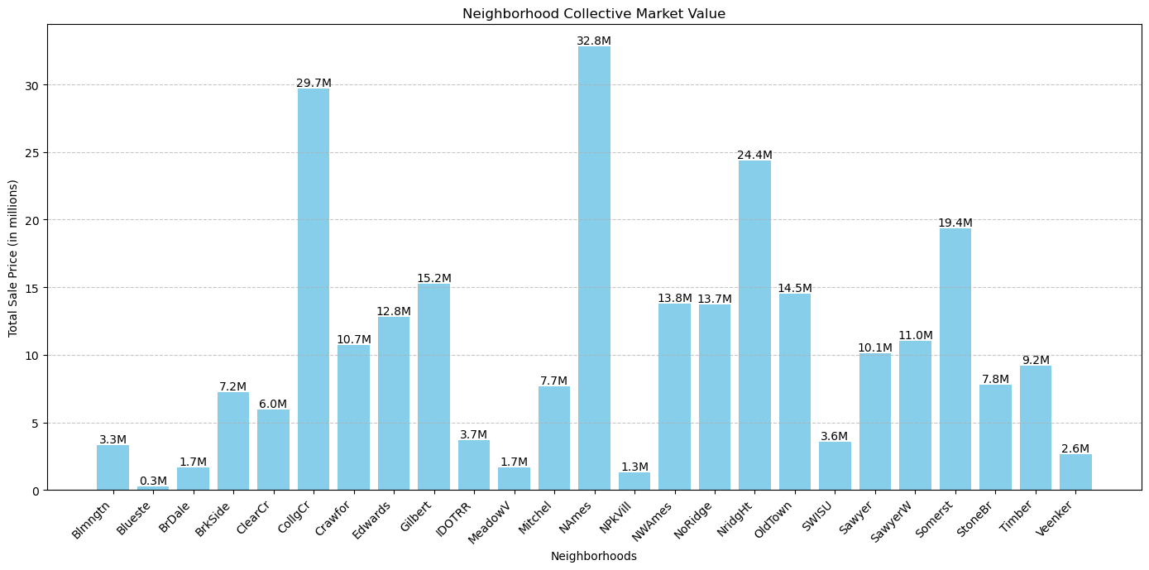

Slide 4
What we found:
Top 5 with highest collective market value neighborhood were North Ames, College Creek, Northridge Heights, Somerset, and Gilbert.
North Ames has the highest collective market value and the highest amount of houses.
Gilbert has the least amount of collective market value.
Rank | Amount of Houses | Collective Market Value
1. North Ames | 225 | $32,815,593
2. College Creek | 150 | $29,694,866
3. Northridge Heights | 77 | $24,352,838
4. Somerset | 86 | $19,383,666
5. Gilbert | 79 | $15,235,506

Slide 5
Average Prices of the Top 5 Neighborhoods:
Northridge Heights has the least amount of houses, but has the highest average price of collective market value.
North Ames has the most amount of houses, but has the least average of collective market value.
Rank | Amount of Houses | Average Sale Price
1. North Ames | 225 | $145,847.08
2. College Creek | 150 | $197,965.77
3. Northridge Heights | 77 | $316,270.62
4. Somerset | 86 | $225,379.84
5. Gilbert | 79 | $192,859.51

Slide 6
What is the overall condition and quality of the houses in the North Ames Neighborhood?
Homes in better condition typically have higher market values and as we found North Ames has the least average sale price.
A neighborhood with well-maintained properties tends to be more attractive to homeowners.
Conversely, a neighborhood with many properties in poor condition might experience declining property values but may attract the attention of investors as a sign of possible growth.

Slide 7
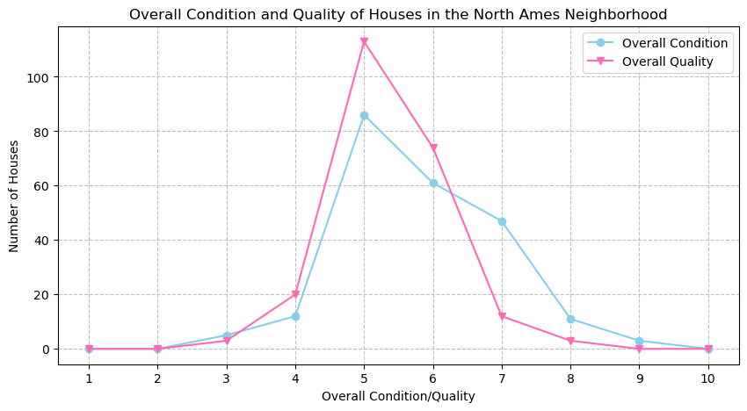

Slide 8

What We Found:
Overall Condition Rating | Number of houses
1 | 0
2 | 0
3 | 5
4 | 12
5 | 86
6 | 61
7 | 47
8 | 11
9 | 3
10 | 0
Overall Quality Rating | Number of houses
1 | 0
2 | 0
3 | 3
4 | 20
5 | 113
6 | 74
7 | 12
8 | 3
9 | 0
10 | 0

Slide 9
What does this mean?
Even though North Ames has the highest collective sale price for houses sold, most of their houses were rated a 5 for both their condition and quality.
This suggests that while there is a higher number of residents in this neighborhood, the main attraction is the affordability.

Slide 10
How many of the Houses with a rating of 5 or above, have a renovation?
Number of renovated houses that had a 5 or above overall rating on condition and quality | Number of not renovated houses that had a 5 or above overall rating on condition and quality
73 | 118

Slide 11
What does this mean?
Investors often look for neighborhoods where the condition of properties suggests potential for improvement.
A higher number of renovated houses can indicate a neighborhood that is experiencing growth and development, which can be a sign of an improving or desirable area. This is a signal for real estate firms and construction companies to put consider this area as target for new opportunities.
Current homeowners that are considering selling their homes can better identify what attracts potential buyers based on renovation trends and competition within the neighborhood.
Financial institutions can use this information to assess the risk and potential value of properties within a given area, influencing mortgage approvals and refinancing options.

Slide 12
Do the houses that were renovated have a higher sale price?
Renovating a house is a form of investment because a house with better features and amenities will for the most part always sell for more.
Our hypothesis is that the houses that were renovated have a higher sale price.

Slide 13
What does this mean?
Average Sale price of the houses that were renovated | Average Sale price of the houses that were not renovated
$153509.93 | $147655.59
The average sale prices of renovated and non-renovated houses offer insights into market trends, buyer preferences, and the financial implications of home improvements.
This information is crucial for homeowners, buyers, investors, real estate agents, and policymakers, influencing decisions related to investment, pricing strategies, community development, and housing policies.
Understanding these dynamics can lead to more informed choices and strategies in the housing market.

Slide 14
Conclusion
What did we learn:
- Neighborhoods with lower sale prices attract more investors, real estate firms, and construction companies because they are seen as an area of high potential growth.
-Based on our graphs and data, we can derive that overall condition and quality does correlate with sale price.
-Renovated houses had a higher average sale price compared to those who weren't renovated.
-North Ames can also be seen as a good area for the construction of buildings like a community center as it has a high number of residents.

